Slide 1
A deferred material rendering system
Tomasz Stachowiak
@h3r2tic

Slide 2
Motivation
Render the whole scene with a handful of draw calls
Shade only the visible pixels
Reduce pixel work in geometry-heavy passes
Less overshading tax
Allow control over shading rate
Support exotic sample generation
Ray-tracing
Texture-space shading
Arbitrary points in space

Slide 3
Inspiration
The Visibility Buffer: A Cache-Friendly Approach to Deferred Shading
Christopher A. Burns and Warren A. Hunt
TL;DR: /* massive simplification */
Render a super thin attribute buffer
Instance ID, Primitive ID
For each pixel
Fetch primitive from the IDs
Manually interpolate attributes from vertices
Shade
… just like a ray-tracer would after having found the intersection!

Slide 4
My contributions
Making barycentric coordinates part of the V-Buffer
No need for ray-triangle intersection
Mesh animation doesn’t require stream-out
Fatter V-Buffer than Intel’s
Scaling to thousands of materials
Disclaimer: GCN-centric
Similar ideas could be made to work on non-GCN

Slide 5



Rendering barycentric coordinates
Vertex stream with {0, 1}, {0, 1}, {0, 0}, … ?
Needs duplicate vertices -> breaks vcache, ~2x slower
Geometry shader?
~2x slower
Domain shader?
~2x slower
Intersect primitive per pixel?
Need to stream-out vertex animation
GCN has a trick up its sleeve ☺

Slide 6
GCN recap: smooth parameter interpolation
in smooth float param;
out vec4 outColor;
void main() {
outColor = param.xxxx;
}
S_MOV_B32 M0, s2
V_INTERP_P1_F32(a0.X) v0 = P10 * v0 + P0
V_INTERP_P2_F32(a0.X) v0 += P20 * v1
V_CVT_PKRTZ_F16_F32 v0, v0, v0
S_NOP(1)
EXP_FP16 v0, v0, v0, v0 (MRT0,VM,DONE)
S_ENDPGM

Slide 7
GCN recap: flat parameter interpolation
in flat float param;
out vec4 outColor;
void main() {
outColor = param.xxxx;
}
S_MOV_B32 M0, s2
V_INTERP_MOV_F32(a0.X) v0 = P0
V_CVT_PKRTZ_F16_F32 v0, v0, v0
S_NOP(1)
EXP_FP16 v0, v0, v0, v0 (MRT0,VM,DONE)
S_ENDPGM

Slide 8
V_INTERP_Px_F32
V_INTERP_P1_F32(a0.X) v0 = P10 * v0 + P0
V_INTERP_P2_F32(a0.X) v0 += P20 * v1
P2
Given:
A parameter of three vertices: P0, P1, P2
Barycentric coordinates: I, J
P10 = P1 – P0
P20 = P2 – P0
Final value = P0 + P10 * I + P20 * J
P20
I, J
P0
P10
P1

Slide 9
V_INTERP_MOV_F32
V_INTERP_MOV_F32(a0.X) v0 = P0
Final value = P0
Same as
V_INTERP_P1_F32 + V_INTERP_P2_F32
with I, J == 0
P0

Slide 10
Pixel shader tampering
Start with a simple one:
Modify ISA
???
PROFIT!
in smooth float param;
out vec2 outColor;
void main() {
outColor = vec2(param, 0);
}
I, J
S_MOV_B32 M0, s2
S_NOP(1)
S_NOP(1)
S_NOP(1)
V_MOV_B32 v2, v1
V_CVT_PKRTZ_F16_F32 v0, v0, v2
V_CVT_PKRTZ_F16_F32 v1, v2, v3
EXP_FP16 (...)
S_ENDPGM
S_MOV_B32 M0, s2
V_MOV_B32 v2, 0
V_MOV_B32 v3, 1.0
V_INTERP_P1_F32(a0.X) v0 = P10*v0 + P0
V_INTERP_P2_F32(a0.X) v0 += P20*v1
V_CVT_PKRTZ_F16_F32 v0, v0, v2
V_CVT_PKRTZ_F16_F32 v1, v2, v3
EXP_FP16 (...)
S_ENDPGM

Slide 11
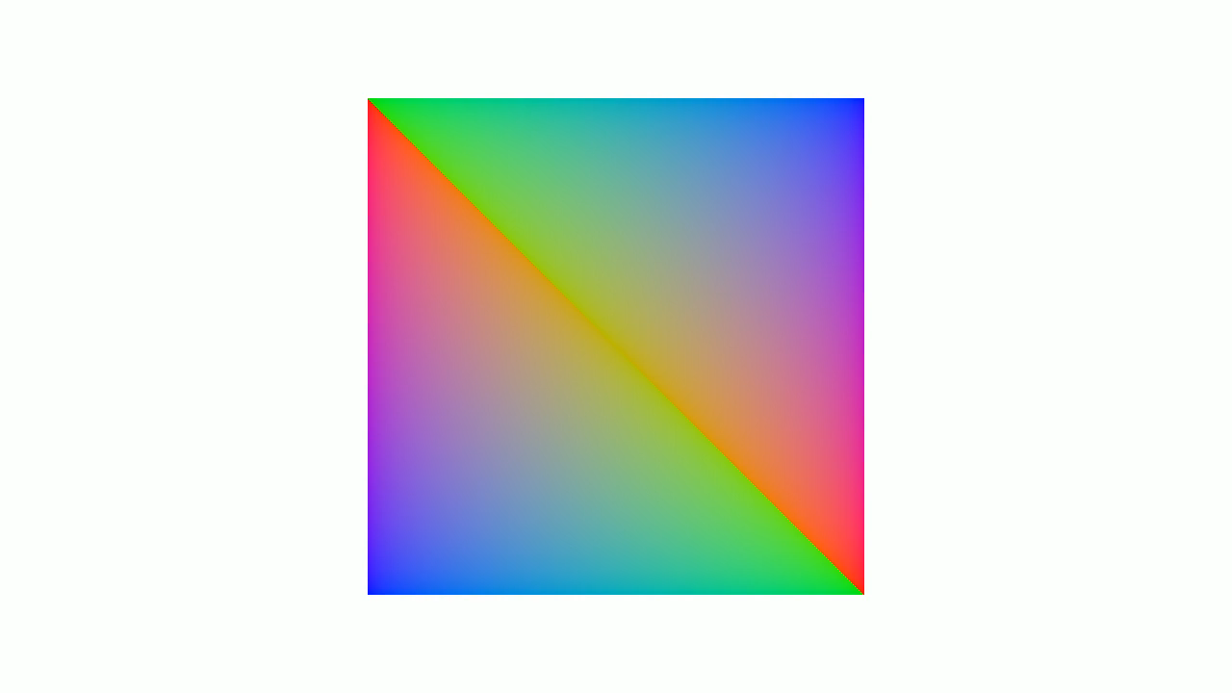

Slide 12

Uh, that almost worked
GPU reorders vertices at Primitive Assembly*
Some sort of slope dependency
Clipping affects it too
I haven’t identified a simple rule yet
Winding order stays the same
Three possible rotations
*thanks, Fabian!
Barycentric coords are reordered to match
Thus pixel shader doesn’t care
We need them to correspond to original mesh data

Slide 13

But wait…
We can use V_INTERP_MOV_F32 to get P0
… and it will be a different vertex depending on rotation
Yet flat parameters also use V_INTERP_MOV_F32
… and it’s always the provoking vertex
GL_LAST_COORD_CONVENTION by default
Behavior depends on interpolation qualifier
flat or smooth

Slide 14
Re-orienting the barycentrics
Export the same parameter twice
out flat float Flat;
out smooth float Smooth;
if P0.Smooth == P0.Flat
Correct orientation!
if P1.Smooth == P0.Flat
Rotate by 1
else
Rotate by 2

Slide 15
Example implementation
Change winding order to CCW
V_SUB_F32 v0, 1.0, v0
V_SUB_F32 v0, v0, v1
V_INTERP_MOV_F32(a0.Z) v2 = P0
V_INTERP_MOV_F32(a2.Z) v3 = P0
V_CMP_EQ_F32 VCC, v2, v3
V_SUB_F32 v4, 1.0, v0
V_SUB_F32 v4, v4, v1
V_CNDMASK_B32 v0, v0, v1
V_CNDMASK_B32 v1, v1, v4
V_MOV_B32 v4, 1.0
V_INTERP_P2_F32(a0.Z) v2 += P20*v4
V_CMP_EQ_F32 VCC, v2, v3
V_SUB_F32 v2, 1.0, v0
V_SUB_F32 v2, v2, v1
V_CNDMASK_B32 v1, v1, v0
V_CNDMASK_B32 v0, v0, v2
Look Ma, no geometry or domain shaders!
Export gl_VertexID as the parameter in VS
Works with indexed draws
Ludicrous speed!
…but can we have barycentrics without hacks, dear IHVs? ☺

Slide 16
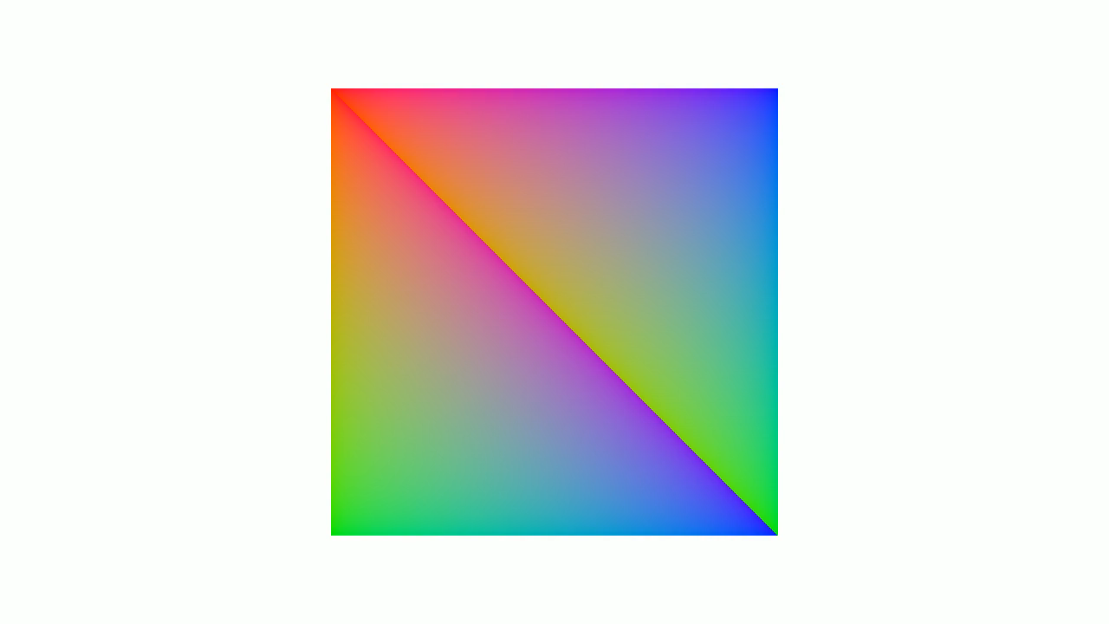

Slide 17
Deferred material shading – overview
Render an attribute buffer
Instance ID, Primitive ID, Material ID, Barycentric U & V
Material ID optional
Barycentric coords typically need more than 16-bit/component
Single RGBA32F
Bin pixels per material
Store pixel screen coords
Dispatch material shaders

Slide 18
Binning pixels per material
Naïve idea: append buffer per material
O(materials * pixels) memory requirements ☹
One append buffer then!
Add pixels in any order, sort later?
Sloooooooooooooow

Slide 19
Counting sort to the rescue
Count pixels using each material O(pixels)
Use global atomics
Exclusive prefix scan pixel counts O(materials)
dst[i] = src[0] + src[1] + … + src[i-1]
Write each pixel to target bin O(pixels)
Count
 | 7 | 24 | 15 | 18
Prefix scan | 0 | 7 | 31 | 46

Slide 20
Global atomic pressure in counting
Crazy contention if pixels use few materials
Run in 8x8 tiles via compute
Find squares of identical materials
Hierarchical reduction
Global atomic add on detected squares
Only one if the tile uses a single material ☺
Internal index via LDS atomics
~1ms -> ~0.18ms
720p, Tonga (R9 285)
Not really optimized otherwise

Slide 21
Dispatching material shaders
One dispatch indirect per material?
Material count could be very high
Abuses the command processor
Might be fine for some use cases!
Ubershader?
The compiler won’t be amused
Pay for the worst case
Shader jump table?
Compile all shaders separately
Dump ISA into a buffer (See “Hacking GCN via OpenGL”)
Dispatcher shader reads material ID, jumps using S_SETPC_B64

Slide 22
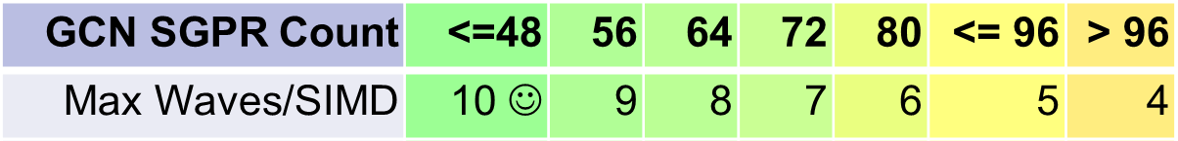
Making it more efficient
Dispatcher shader must have worst-case resource allocation
VGPR, SGPR, LDS
In practice: occupancy of 1 ☹
Group shaders by max occupancy!

Slide 23
Waves/SIMD | 10 | 9 | 8 | 7 | 6 | 5 | 4 | 3 | 2 | 1
Max VGPRs | 24 | 28 | 32 | 36 | 40 | 48 | 64 | 84 | 128 | 256
Max SGPRs | 48 | 56 | 64 | 72 | 80 | 96 | 102 | 102 | 102 | 102

Slide 24
So how about ten dispatcher shaders?
Check the SGPR, VGPR, and LDS usage of each material shader
Bin it depending on max occupancy
Exactly ten bins
Create a shader for each bin
Pre-sort materials by bin
Shade everything with ten dispatches
Still just one sub-allocated pixel list
Now shading at proper occupancy

Slide 25

But wait, those materials aren’t compatible!
If two shaders use different resources, we can’t merge them
Say, one needs no textures
Another uses a normal map and a diffuse texture
Or else.

Slide 26

BINDLESS
ALL THE THINGS!

Slide 27
One resource to rule them all
layout(std140, binding = 0) uniform BindlessResources
{
usamplerBuffer ClassificationResult;
usamplerBuffer WorkgroupData;
usamplerBuffer GlobalIndexBuffer;
usamplerBuffer GlobalVertexBuffer;
…
};

Slide 28
Unfortunately that’s a bit ugly…
uvec3 fetchTriangleIndices(int offset)
{
usamplerBuffer buf = GlobalIndexBuffer;
if (0 == (offset & 3)) {
return texelFetch(buf, offset >> 2).xyz;
} else if (1 == (offset & 3)) {
return texelFetch(buf, offset >> 2).yzw;
} else if (2 == (offset & 3)) {
return uvec3(texelFetch(buf, offset >> 2).zw, texelFetch(buf, (offset >> 2) + 1).x);
} else {
return uvec3(texelFetch(buf, offset >> 2).w, texelFetch(buf, (offset >> 2) + 1).xy);
}
}
Can haz buffer pointers, GLSL?
NV_shader_buffer_load is so much nicer!

Slide 29

… but it gets the job done
The ugly sits in wrapper functions
All material shaders now compatible
Only one resource
No descriptor table necessary
Buffer descriptor right in SGPRs
Good job, driver!
Render everything with:
1 draw call
… or however many vertex shaders you have
16 compute dispatches
6 for classification and work generation
10 for materials

Slide 30
Let’s test it, shall we?
Should be able to support thousands of materials
Difficult to get representative shaders
At least out in the open :P
I could write a few, but I need to sleep sometimes

Slide 31



Oh, look, Shadertoy has a web API :D
Can fetch us all the public shaders
Resources, code, meta info
Grab the purely procedural ones for now
Could support texture inputs just fine
Some fail to compile
Derivatives
Audio channels
WebGL compatibility issues
Skip them

Slide 32
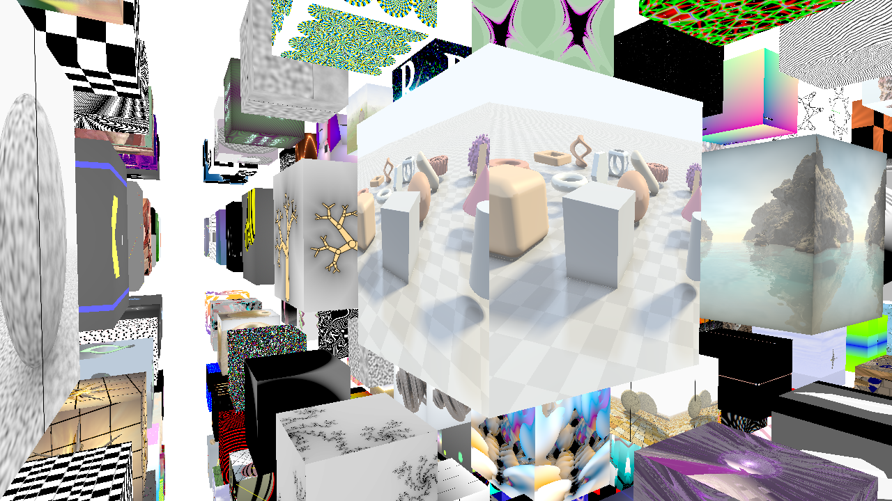

Slide 33
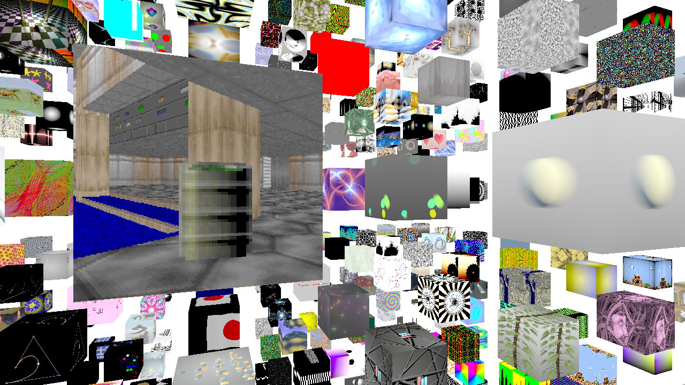

Slide 34
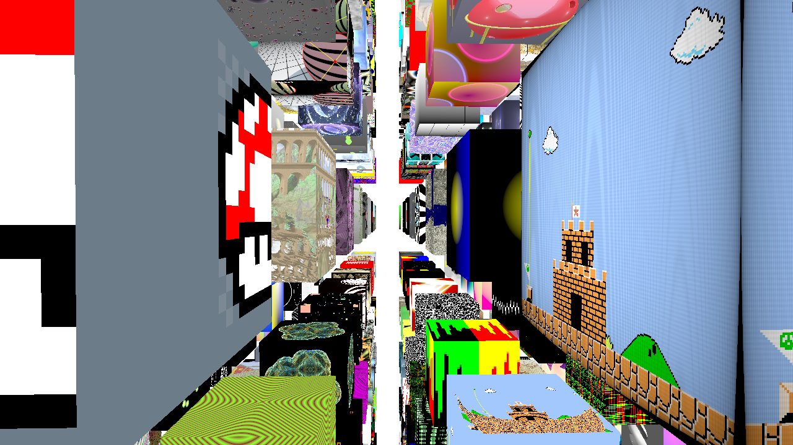

Slide 35
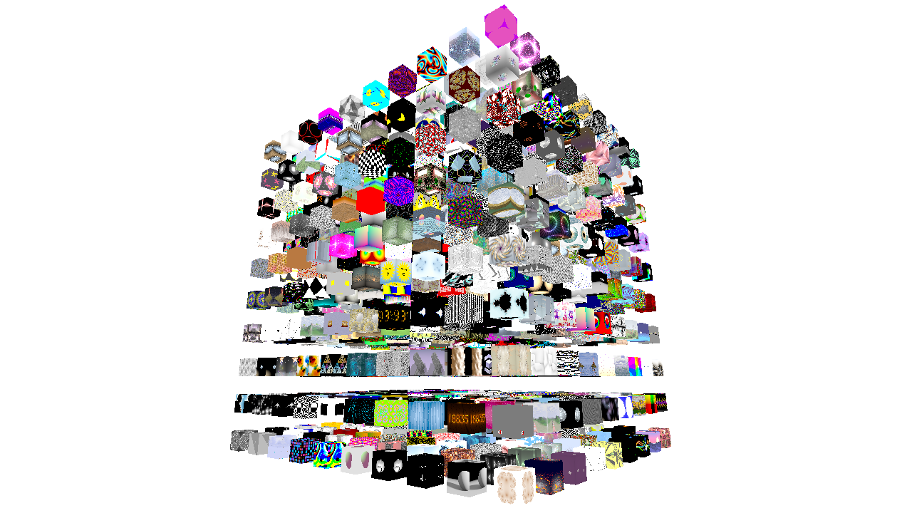

Slide 36
Making of the Shadertoy Metaverse®™™
892 shaders compile without errors
Dump ISA from all shaders into a single buffer
~14 MB worth of GCN code
Render a grid of 892 cubes
Could be one draw call
Only difference: written material ID
16 compute dispatches render all the materials

Slide 37
Shadertoy Metaverse®™™ takeaways
No overshading in the material pass
Other inefficiencies (cache coherency, etc.)
No need to sort front-to-back
Mostly just worked
A few shaders have artifacts
More homework
Shader compilation takes a while
Can serialize ISA and later bypass GL altogether

Slide 38
892 cubes in a grid look like a mess…
… so let’s see just 64 Shadertoys in a video!
Note: I didn’t write any of those;
many awesome people did!

Slide 39
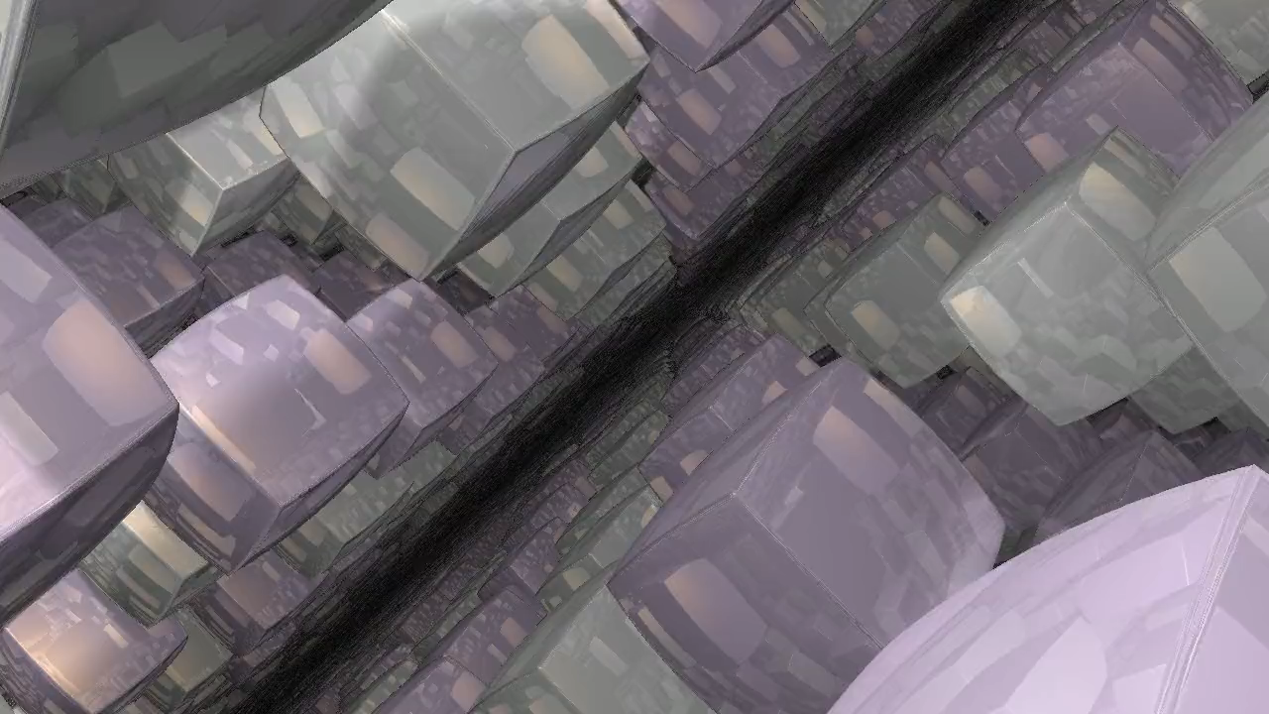

Slide 40


Bonus: variable-rate shading
Quite easy to do in the framework
Classification pass controls shading rate
Example:
if (same material && similar depth in 2x2 tile) {
if ((pixel.x | pixel.y) & 1) {
skip pixel;
} else {
add pixel as 2x2 tile;
}
}

Slide 41
Issues
Alpha tested-rendering
Mask textures still needed in the geometry pass
No transparency support
Per pixel linked lists?
GPU underutilized during geometry pass
Run some async compute!
No automatic derivatives
Calculate analytically (expensive)
Finite-differencing permutation for 2x2 tiles?

Slide 42
Where to next?
Shading samples can be generated by anything
Only barycentric coords, instance ID, and primitive ID are needed
Ray-tracing?
Texture space?
I want a modern surface cache!
Lots of room for optimization and research
Group by primitive, prefetch params into LDS
Pack shading samples spatially for memory coherency
Can the HW scheduler mix low-VGPR/hi-SGPR shaders with hi-VGPR/low-SGPR?
Smarter variable-rate shading

Slide 43
Extension: Fractional rendering
Variable rate simple with deferred material shading
Pixel work explicitly created in classification pass
if (someCondition) schedulePixelShading(x, y);
Spatial
Schedule pixels sparsely
Fill in gaps
Temporal
Schedule pixel if rand() > k
Reproject gaps

Slide 44
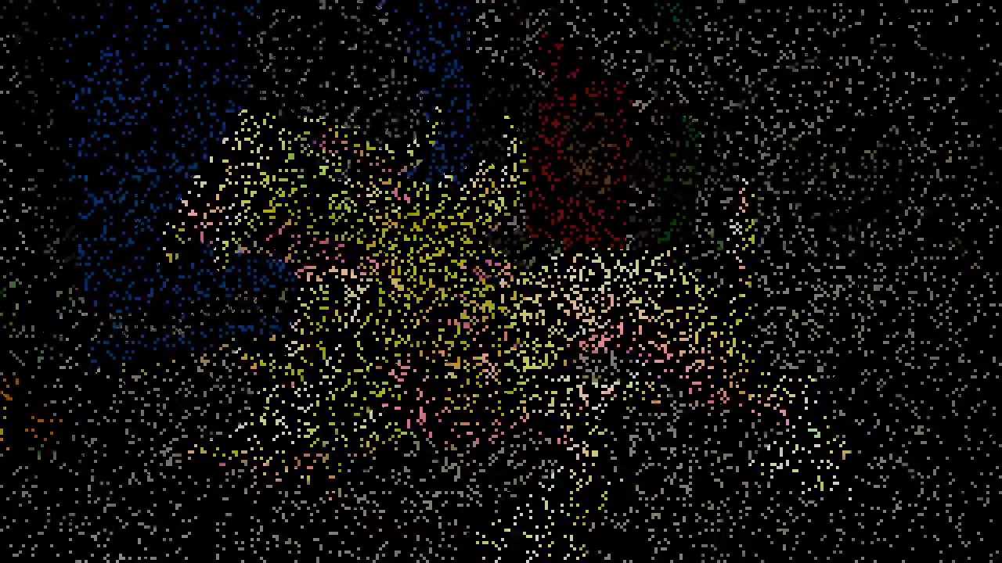
if (rand() > k)

Slide 45
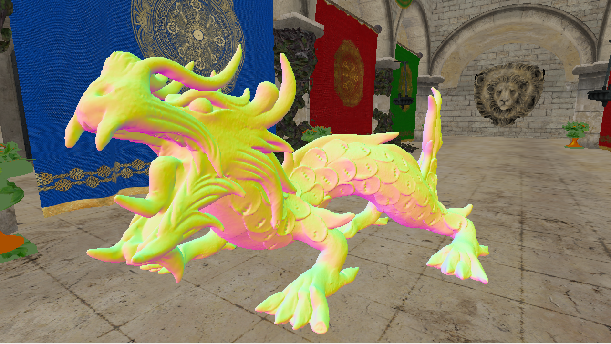
+ Temporal reprojeciton

Slide 46

+ Whoops

Slide 47
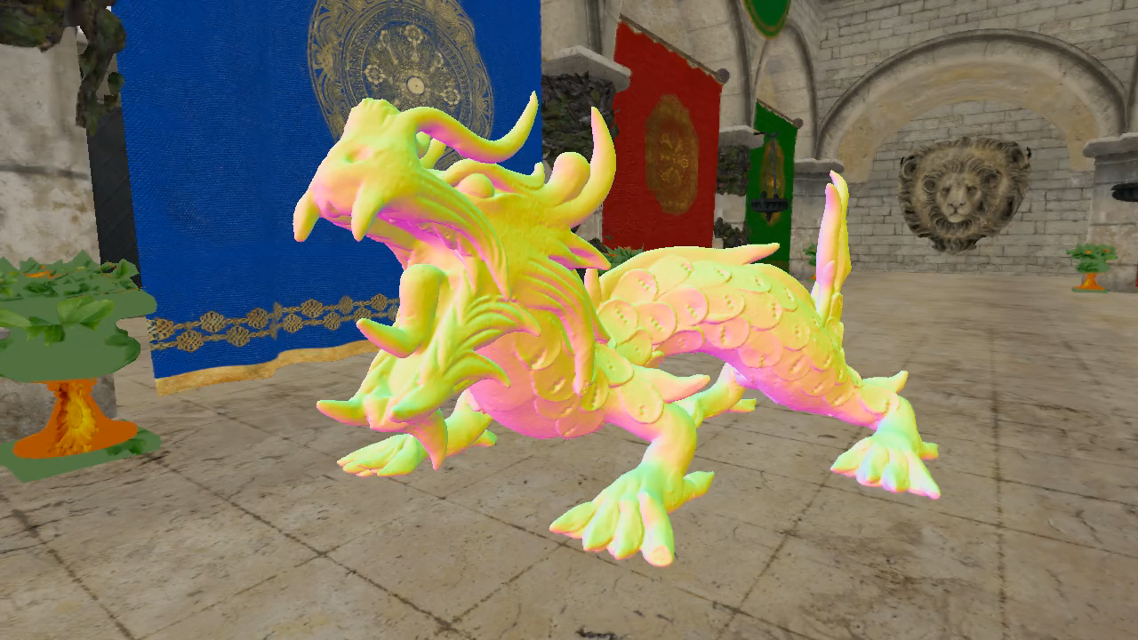
+ Explicit disocclusion handling

Slide 48
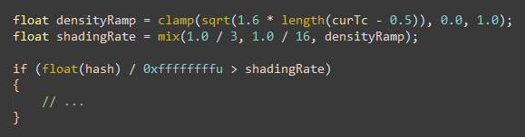
Foveated rendering
Vary random threshold over image
Radial distance to screen center
Average shading cost (rate) is 1/5 in this case

Slide 49
Temporal + spatial
Disocclusions can be significant
Camera cuts, nearby objects
All pixels in the worst case
Shade disocclusions at quarter-rate
Almost the same quality in practice
1/4th of the cost
Same idea as before
Splat the same color to 2x2 pixel blocks

Slide 50
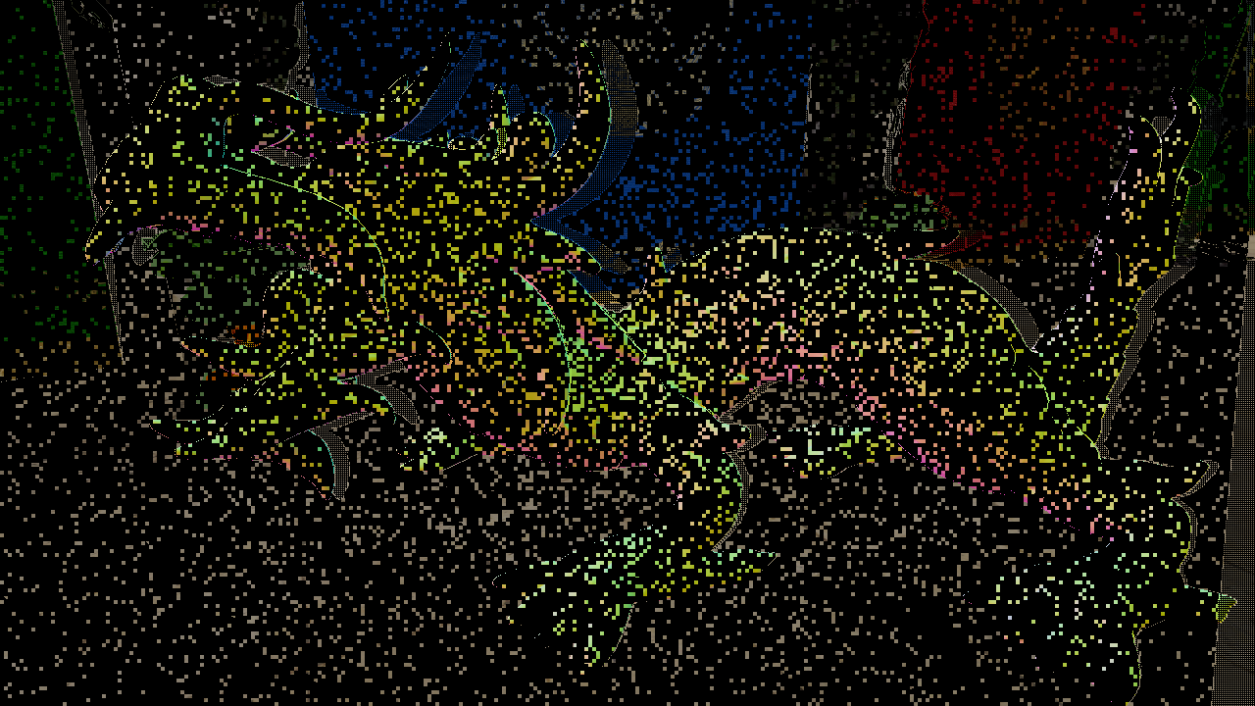
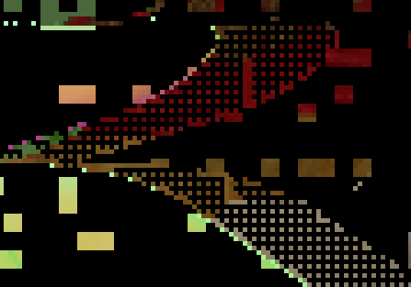
Quarter-rate disocclusions

Slide 51
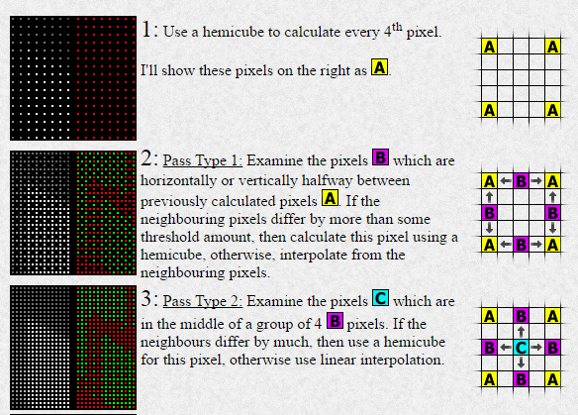
What is it good for?
View independent-stuff
Diffuse lighting
AO
G-Buffer parameters
Primary artifact is blurriness
High frequency specular breaks it
Predict it and shade at higher rate?
Do spec separately?
Shade adaptively?
Credit: Hugo Elias (Radiosity)

Slide 52
Thanks!

